Slide 1
PUBPOL 639 Quantitative Methods for Program Evaluation
Section 9 – March 25th 2011
Yann Toullec – ytoullec@umich.edu

Slide 2
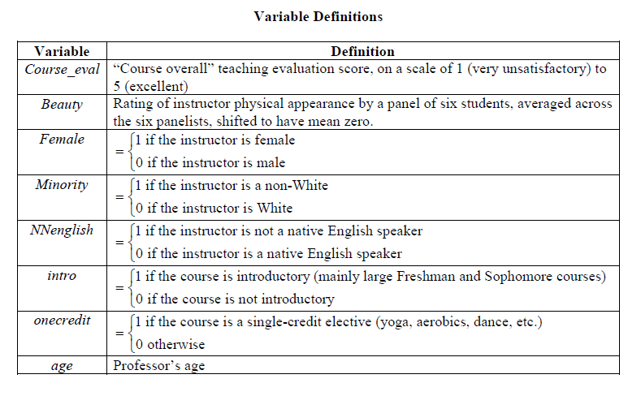
Teacher ratings!
New database!
Today’s topic is to study the relationship between teacher’s rating, physical appearance and age
On Ctools : teacher_ratings.dta

Slide 3
Regular multivariate regression
What is the relationship between beauty and teaching evaluation score? Is it a big relationship?
What do you think would happen if age was added in the regression? Explain.
Check your guess on Stata.

Slide 4
Introducing a quadratic term
Generate a plot of course_eval against beauty. Does the relationship look linear?
Using the command generate, create the variable beauty² and call it beauty_2
Using the command estimates store. Create and store the regressions of course_eval on :
beauty
beauty and age
beauty and beauty²
beauty, beauty² and age

Slide 5
Interpretation
Using the command estimates table, generate a summary of your results on Stata.
Questions:
Using the full model : describe qualitatively and qualitatively the relationship between physical appearance and course evaluation controlling for age
Does omitting age bias our estimate of the relationship between course evaluation and physical appearance? If so, how? If not, which OVB condition is not satisfied?
Is there a significant quadratic relationship between course evaluation and physical appearance? Why or why not?
Using the full model (the last one): is there a significant relationship between course evaluation and physical appearance controlling for age?

Slide 6
Relationship between physical appearance and course evaluation controlling for age
Does omitting age bias our estimates?

Slide 7
Is the relationship quadratic?
Is there a statistically significant relationship between course evaluation and beauty?

Slide 8
Categorical dummies
Create a categorical variable “beauty_category” that takes the values:
1 for teacher’s in the 1st quartile of beauty ranking
2 for teacher’s between the 1st quartile and the median of beauty ranking
3 for teacher’s between the median and the 3rd quartile of beauty ranking
4 for teacher’s in the 4th quartile of beauty ranking
You can give name to your categories if you think it helps

Slide 9
Categorical dummies
Regress teacher’s rating on beauty_category. Interpret your estimated coefficients.

Slide 10
From the categorical variable to the saturated model
Create three dummy variables :
“low” if beauty_ranking=1
“average_low” if beauty_ranking=2
“average_low” if beauty_ranking=3
“high” if beauty_ranking=4
Now regress teacher’s ranking on three of your dummies (so you choose the omitted categories) and interpret the coefficients. What type of model is it?
Add age to your previous regression and interpret the coefficient on age. What would a graphical representation of your regression would look like?

Slide 11
From the categorical variable to the saturated model
You want to look at the difference between male and female teachers within each category. How many categories do you need to create to saturate your model?
How would you do it on Stata?

